Slide 1

Jumpman23 Market Analysis
Stephen Stark
October 2020

Slide 2
Analysis Overview
Executive Summary
Dataset
Data Integrity Issues
New York Market Update
Growth Strategies
Results & Next Steps
Jumpman23 is an on-demand delivery platform connecting “Jumpmen” and customers purchasing a variety of goods. Jumpman23 will send Jumpmen to merchants to purchase and pickup any items requested by the customer. Whenever possible, Jumpman23 will order the requested items ahead to save the Jumpmen time. Each time a Jumpman23 delivery is completed, a record is saved to the Jumpman23 database that contains information about that delivery. Jumpman23 is growing fast and has just launched in its newest market -- New York City
The CEO of Jumpman23 has just asked you ​how are things going in New York​? The CEO is considering pouring more resources into NYC and wants you to come up with a plan to grow the market by 20% in two months.

Slide 3
Executive Summary
There aren’t significant data integrity issues
The New York market is strong:
Completed X transactions in the month of October 2014
Average delivery time was xx mins
X unique customers, over x% order more than once, x% more than twice
Dinner is the most popular meal ordered
Engage the most and least frequent customers and Jumpmen:
How could the product be improved? Biggest hurdles? Greatest successes?
Growth strategies:

Slide 4



Jumpman to Customer Delivery Process
Delivery Starts
Jumpman arrives at the pickup location
Places order
Departs pickup location
Arrives at customer’s location
Jumpman23 is an on-demand delivery platform connecting “Jumpmen” and customers purchasing a variety of goods. Jumpman23 will send Jumpmen to merchants to purchase and pickup any items requested by the customer. Whenever possible, Jumpman23 will order the requested items ahead to save the Jumpmen time. Each time a Jumpman23 delivery is completed, a record is saved to the Jumpman23 database that contains information about that delivery. Jumpman23 is growing fast and has just launched in its newest market -- New York City.
Attribute | Entry
delivery_id | 1476547
customer_id | 83095
jumpman_id | 132725
vehicle_type | bicycle
pickup_place | Bareburger
place_category | Burger
item_name | Bare Sodas
item_quantity | 1
item_category_name | Drinks
how_long_it_took_to_order | 0:06:45
pickup_lat | 40.7285
pickup_lon | -73.9984
dropoff_lat | 40.7286
dropoff_lon | -73.9951
when_the_delivery_started | 10/28/14 21:39
when_the_Jumpman_arrived_at_pickup | 10/28/14 21:37
when_the_Jumpman_left_pickup | 10/28/14 21:59
when_the_Jumpman_arrived_at_dropoff | 10/28/14 22:04

Slide 5
Dataset
Sample Record
Attribute | Entry
delivery_id | 1476547
customer_id | 83095
jumpman_id | 132725
vehicle_type | bicycle
pickup_place | Bareburger
place_category | Burger
item_name | Bare Sodas
item_quantity | 1
item_category_name | Drinks
how_long_it_took_to_order | 0:06:45
pickup_lat | 40.7285
pickup_lon | -73.9984
dropoff_lat | 40.7286
dropoff_lon | -73.9951
when_the_delivery_started | 10/28/14 21:39
when_the_Jumpman_arrived_at_pickup | 10/28/14 21:37
when_the_Jumpman_left_pickup | 10/28/14 21:59
when_the_Jumpman_arrived_at_dropoff | 10/28/14 22:04
5,900+ records and 18 features
Engineered Features:
-One
-Two
-Three

Slide 6
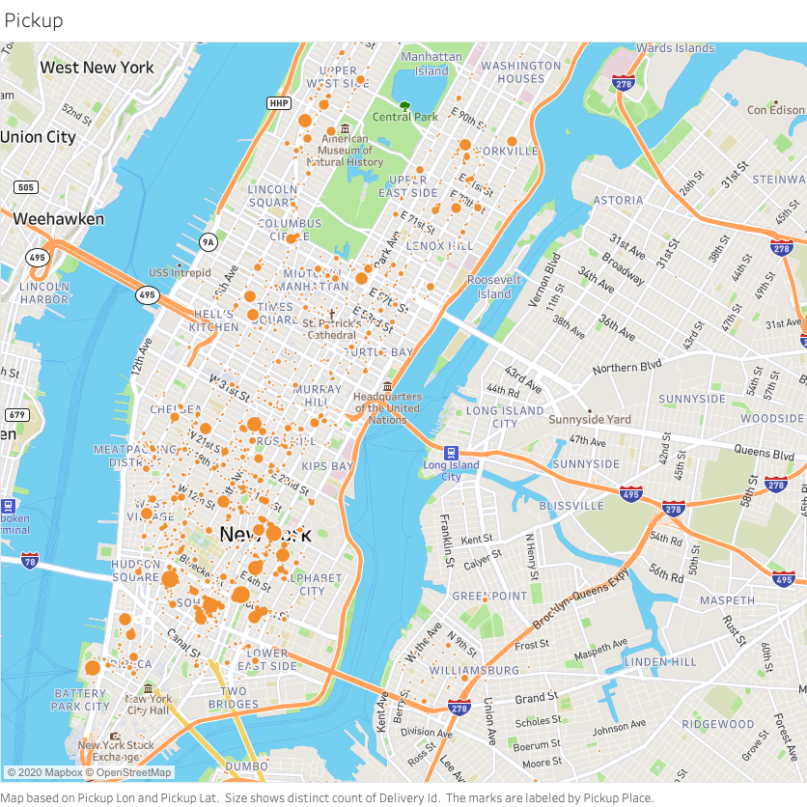
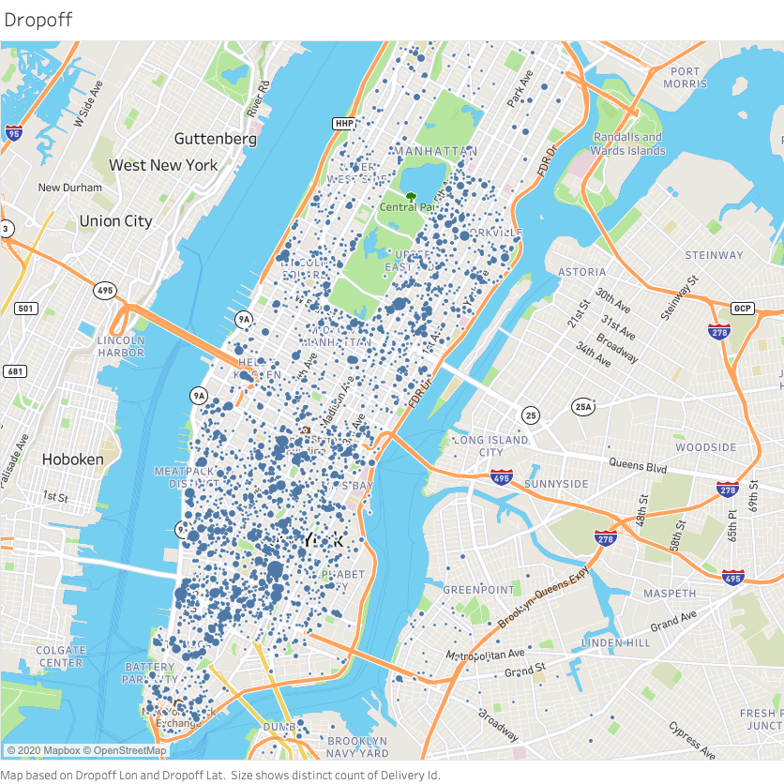
Popular Pickup & Dropoff Locations

Slide 7
Data Integrity Concerns
There is a clear systematic issue in data collection. Many of the records with with missing data are missing for multiple attributes. For the purposes of this analysis, I assumed the following:
Place category, item name, item quantity, category name were all replaced with “not disclosed”
Estimated how long it took to order using an average value for the dataset. My analysis showed there was not meaningful deviation by place category with sufficient data
Records missing Jumpman pickup arrival and departure times were dropped from the dataset
For next steps, I would recommend a classification model to predict the category of the restaurant name. This could be implemented using natural language processing and a simple machine learning.
Attribute | Count
delivery_id | 0
customer_id | 0
jumpman_id | 0
vehicle_type | 0
pickup_place | 0
place_category | 883
item_name | 1230
item_quantity | 1230
item_category_name | 1230
how_long_it_took_to_order | 2945
pickup_lat | 0
pickup_lon | 0
dropoff_lat | 0
dropoff_lon | 0
when_the_delivery_started | 0
when_the_Jumpman_arrived_at_pickup | 550
when_the_Jumpman_left_pickup | 550
when_the_Jumpman_arrived_at_dropoff | 0

Slide 8
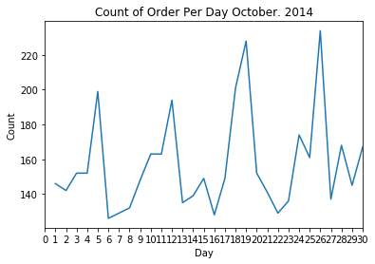
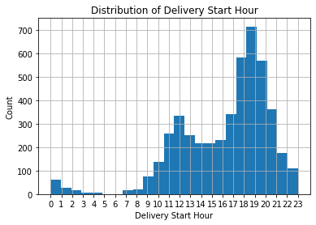

Slide 9
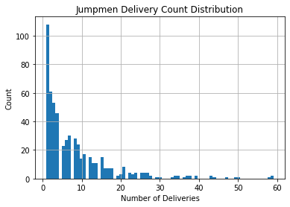
Who are the Jumpmen?
565 Jumpmen completed 4,719 deliveries in October 2014
Half completed 5 deliveries or more
Avg. = 8.4
Max = 59

Slide 14
Appendix
Links to Analysis
Thank you for the opportunity, I can be reached at
stephenstark@uchicago.edu
Stephen stark linkedin
Stephen stark github

